Slide 1
School Management System

Slide 2
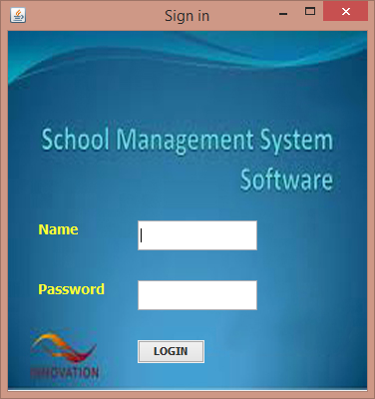
Login Form
Name: hamza
Password: 123

Slide 3
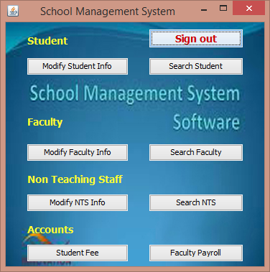
Main/Menu Page
Via this page you can use all features of this software.

Slide 4
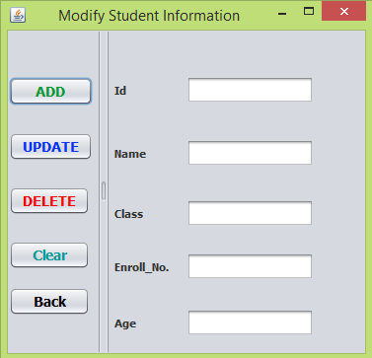
Add/Modify Student
On this form ,you can add, update, delete student information.

Slide 5
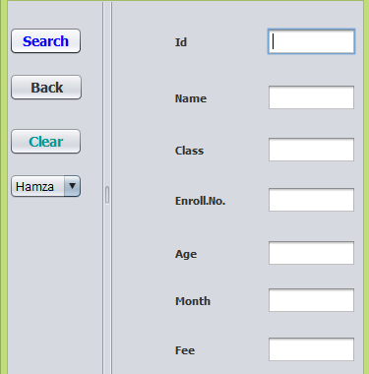
Search Student
On this form , you can search any student information who enrolled and paid fee also, by giving id and can see name of students enrolled in school in combo box.

Slide 6
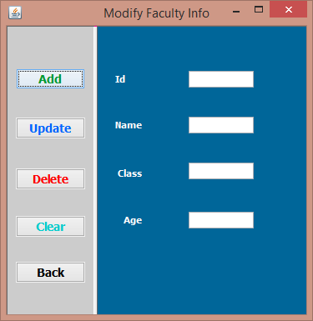
Add/Modify Faculty
On this form ,you can add, update, delete faculty information.

Slide 7
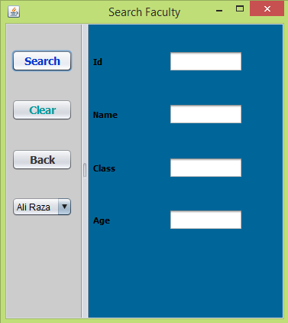
Search Faculty
On this form , you can search any faculty information by giving id and can see name of faculty in combo box.

Slide 8
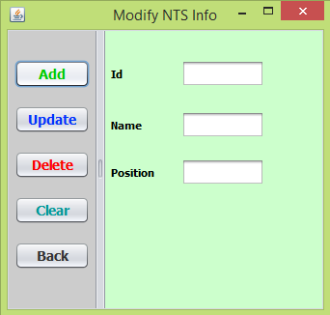
Add/Modify Non Teaching Staff
On this form ,you can add, update, delete non teaching staff information

Slide 9
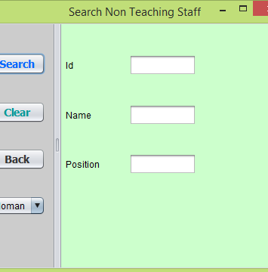
Search Non Teaching Staff
On this form , you can search any NTS member information by giving id and can see name of NTS member in combo box.

Slide 10
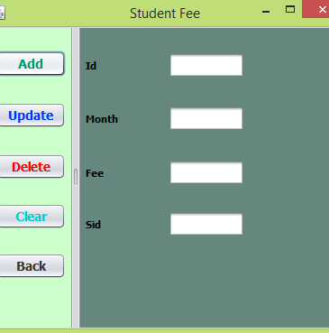
Student Fee(Accounts)
On this form ,you can add, update, delete fee(Paid/Not Paid) information but instruction is you don’t need to write Not Paid ,only write Paid always, that’s why you can differentiate b/w students who paid or not paid fee.

Slide 11
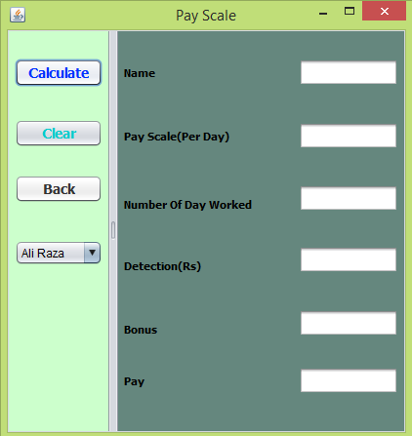
Payroll (Accounts)
On this form you can calculate salary of faculty a/c to given criteria.

